Slide 1
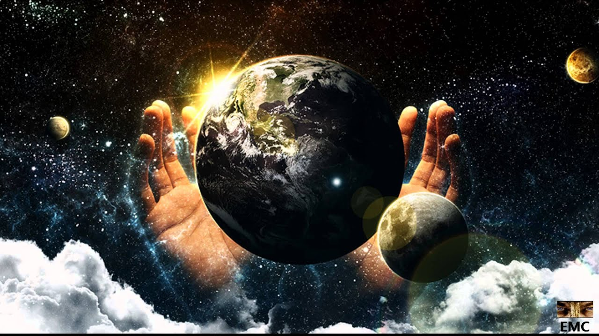
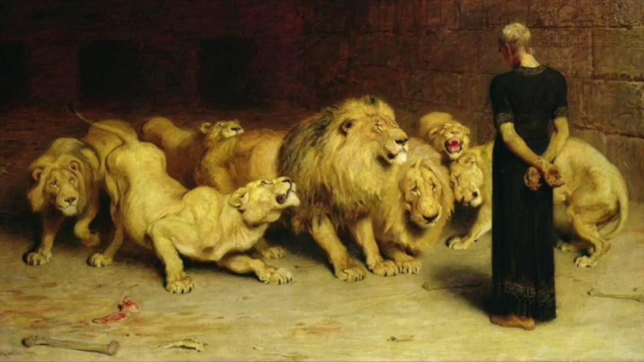
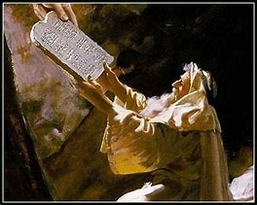
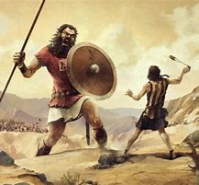
Old Testament Survey
Lesson 1 – Overview of the Survey

Slide 2
Topics
Why study the Old Testament?
Theme of the study
Old Testament summary
Lesson schedule
Closing items

Slide 3
Why Study the Old Testament?
Leads us to Christ
Prophecies to confirm the gospel
Examples for us
The nature and expectations of God
Historical perspective

Slide 4
Leads Us to Christ
Gal 3:24
“Therefore the law was our tutor to bring us to Christ”
Acts 17:11
Speaking of the Bereans: “These were more fair-minded [“noble”] than those in Thessalonica, in that they received the word with all readiness, and searched the Scriptures daily to find out whether these things were so.”
Acts 8:30
Speaking of the Ethiopian eunuch: “So Philip ran to him, and heard him reading the prophet Isaiah, and said, “Do you understand what you are reading?” And he said, “How can I, unless someone guides me?....Then Philip opened his mouth, and beginning at this Scripture [Isa 53:7,8], preached Jesus to him.”

Slide 5
Prophecies to Confirm the Gospel (1)
Matt 5:17
Jesus: “Do not think that I came to destroy the Law of the Prophets. I did not come to destroy but to fulfill.”
Luke 24:44
Jesus: “These are the words which I spoke to you while I was still with you, that all things must be fulfilled which were written in the Law of Moses and the Prophets and the Psalms concerning Me.”
Matt 1:22
So all this was done that it might be fulfilled which was spoken by the Lord through the prophet…
Matt 26:52-54
Jesus: “Put your sword in its place….How then could the Scriptures be fulfilled, that it must happen thus?

Slide 6
Prophecies to Confirm the Gospel (2)
Isaiah 53:4-5
Speaking of Jesus: “Surely He has borne our griefs and carried our sorrows….But He was wounded for our transgressions, He was bruised for our iniquities; The chastisement for our peace was upon Him, and by His stripes we are healed.”
Acts 3:18
Peter: “But those things which God foretold by the mouth of all His prophets, that the Christ would suffer, He has thus fulfilled.”
Daniel 2:44
Daniel: “And in the days of these kings [Rome] the God of heaven will set up a kingdom which shall never be destroyed [the church].”

Slide 7
Examples for Us (1)
James 5:10-11a
“My brethren, take the prophets, who spoke in the name of the Lord, as an example of suffering and patience. Indeed we count them blessed who endure.”
Jude 7
“As Sodom and Gomorrah….having given themselves over to sexual immorality and gone after strange flesh, are set forth as an example, suffering the vengeance of eternal fire.”
1 Corinthians 10:6-11
“Now these things became our examples, to the intent that we should not lust after evil things as they also lusted. And do not become idolaters as were some of them….Nor let us commit sexual immorality, as some of them did….nor let us tempt Christ, as some of them also tempted….nor complain, as some of them….Now all these things happened to them as examples, and they were written for our admonition.”

Slide 8
Examples for Us (2)
David – A man after God’s own heart
Ezekiel – Sent as a watchman to warn others
Zedekiah – Wouldn’t listen to God’s word via Jeremiah
Jonah – Ran away from his duty to God
Daniel – Would not defile himself

Slide 9
Nature and Expectations of God
Psalms 33:8-9a
“Let all the earth fear the Lord; Let all the inhabitants of the world stand in awe of Him. For He spoke, and it was done; He commanded, and it stood fast.”
Exodus 20:4-5
“You shall not make for yourself a carved image….you shall not bow down to them nor serve them. For I, the Lord your God, am a jealous God”
2 Kings 17:22-23
“For the children of Israel walked in all the sins of Jeroboam which he did; they did not depart from them, until the Lord removed Israel out of His sight, as He had said by all His servants the prophets.”

Slide 10
Nature and Expectations of God
Deut 6:5
“You shall love the Lord your God will all your heart, with all your soul, and with all your strength.”
Lev 19:18
“….you shall love your neighbor as yourself”
Micah 6:8
“He has shown you, O man, what is good; and what does the Lord require of you but to do justly, to love mercy, and to walk humbly with your God?”

Slide 11
Historical Perspective
Creation – Gen 1
Global flood – Gen 8
Major world events – 1 Samuel through 2 Chronicles
Detailed evolution of the dominate world empires – Daniel
Babylon, Persians, Greeks, Romans

Slide 12
Power Verses from the Old Testament
Genesis 1:1
“In the beginning God created the heavens and the earth.”
Psalms 22
“My God, My God, why have You forsaken Me?”
Psalms 23
“The Lord is my shepherd; I shall not want.”
Ecclesiastes 12:13
“Fear God and keep His commandments, for this is man’s all.”
Ezekiel 33:7-9
“I have made you a watchman for the house of Israel”

Slide 13
Theme of the Study
Gal 3:24
“our tutor to bring us to Christ”

Slide 14
Structure of the Old Testament
Section | Key Topics
Genesis - Deuteronomy | Creation through the exodus, books of the law
Joshua - Ruth | Conquest of Canaan through the time of the judges
1 Samuel – 2 Chronicles | The time of the kings, the divided kingdom, the captivity
Ezra - Esther | The return to Judah from captivity
Psalms – Song of Solomon | Books of poetry and wisdom
Isaiah - Daniel | Major prophets
Hosea - Malachi | Minor prophets

Slide 15
Summary of OT Bible Chronology (In Round Numbers)
Event | Approximate Dates
Creation | ~4,200 BC
Noah / The Flood | ~2,600 BC
Joseph / Israel to Egypt | ~2,000 BC
Moses / Exodus from Egypt | ~1,500 BC
Solomon / 4th year of his reign | 970 BC
The Babylonian captivity | ~606 BC
Return to Judah | ~536 BC
Birth of Christ | ~3 BC

Slide 16
Date | Lesson Topic | Class Leader
Dec 1 (W) | Why study the OT? Theme of the OT. OT Summary. | Rick
Dec 5 (S) | Genesis (part 1) | Jordan
Dec 8 (W) | Genesis (part 2) | Jordan
Dec 12 (S) | The Exodus (Egypt to Canaan) | Rick
Dec 15 (W) | The Law | Rick
Dec 19 (S) | Joshua and Judges (part 1) | Jordan
Dec 22 (W) | Joshua and Judges (part 2) | Jordan
Dec 26 (S) | The United Kingdom: Saul, David, and Solomon | Rick
Jan 2 (S) | The Divided Kingdom: Israel | Jordan
Jan 5 (W) | The Divided Kingdom: Judah | Rick
Jan 9 (S) | Books of Poetry and Wisdom | Jordan
Jan 12 (W) | Major Prophets: Isaiah, Jeremiah, Lamentations, Ezekiel, Daniel | Rick
Jan 16 (S) | Brief OT summary, between the testaments | Jordan

Slide 17
Closing Items
Any specific topics or questions to address during the study?
Lesson distribution:
Website, email, hard copy, other?

Slide 18
Next Sunday’s Class
Genesis – Part 1
Class Leader: Jordan

Slide 19
Thanks

